Slide 1
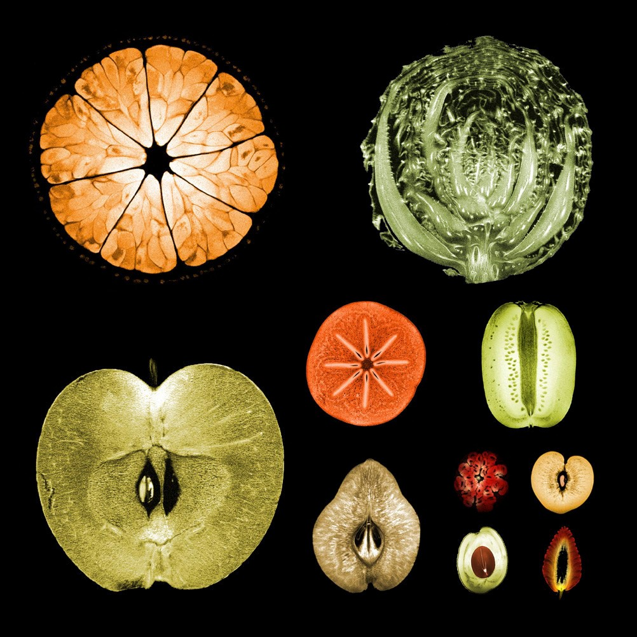
Python in Agricultural Technology
Pyladies Amsterdam
20th June 2023
Neha Kalia
SE @Source

Slide 2
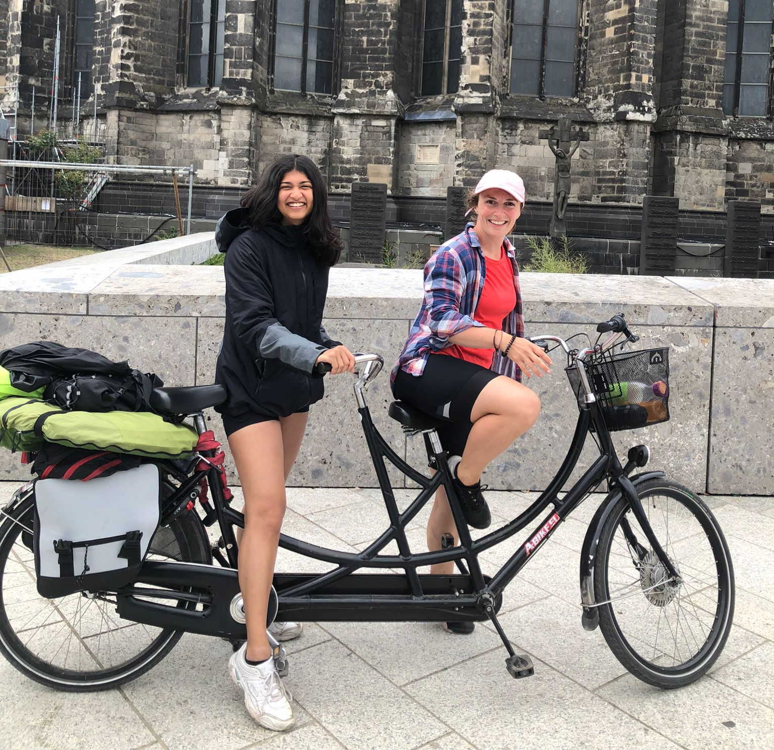
About me
BSc Computer Science and Engineering @TUDelft
Software engineer @Source

Slide 3
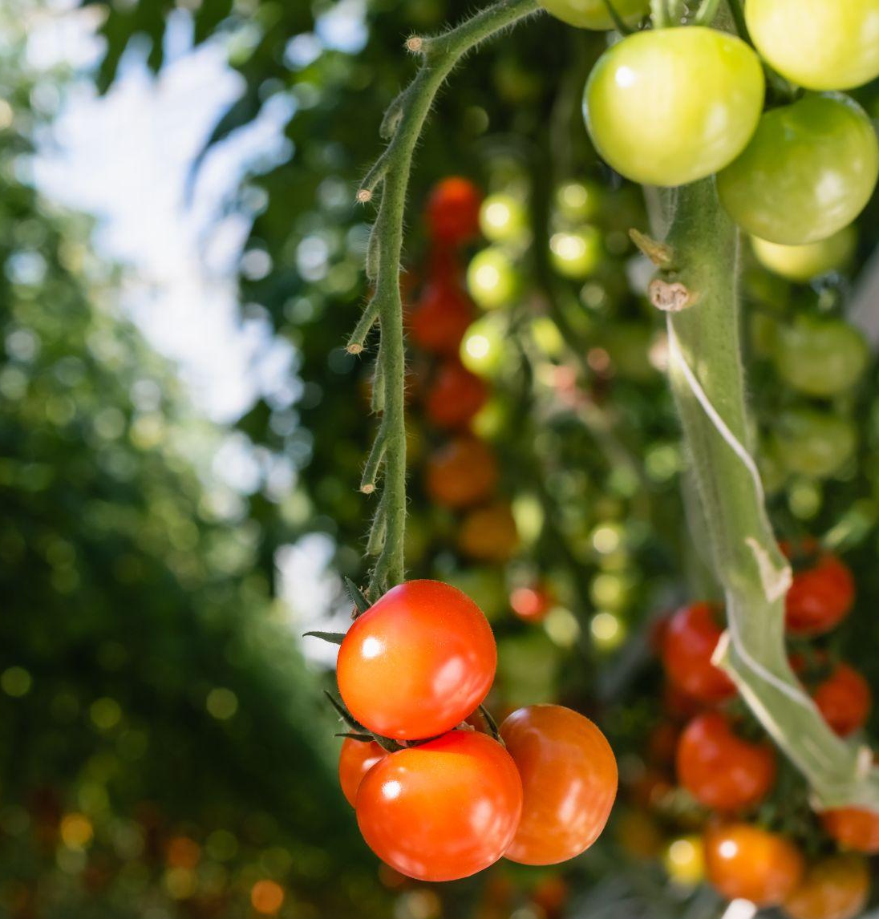
What we’ll talk about today
Evolution of agrotech
Software that empowers growers in modern farms
Deep dive on building a real life use case

Slide 4
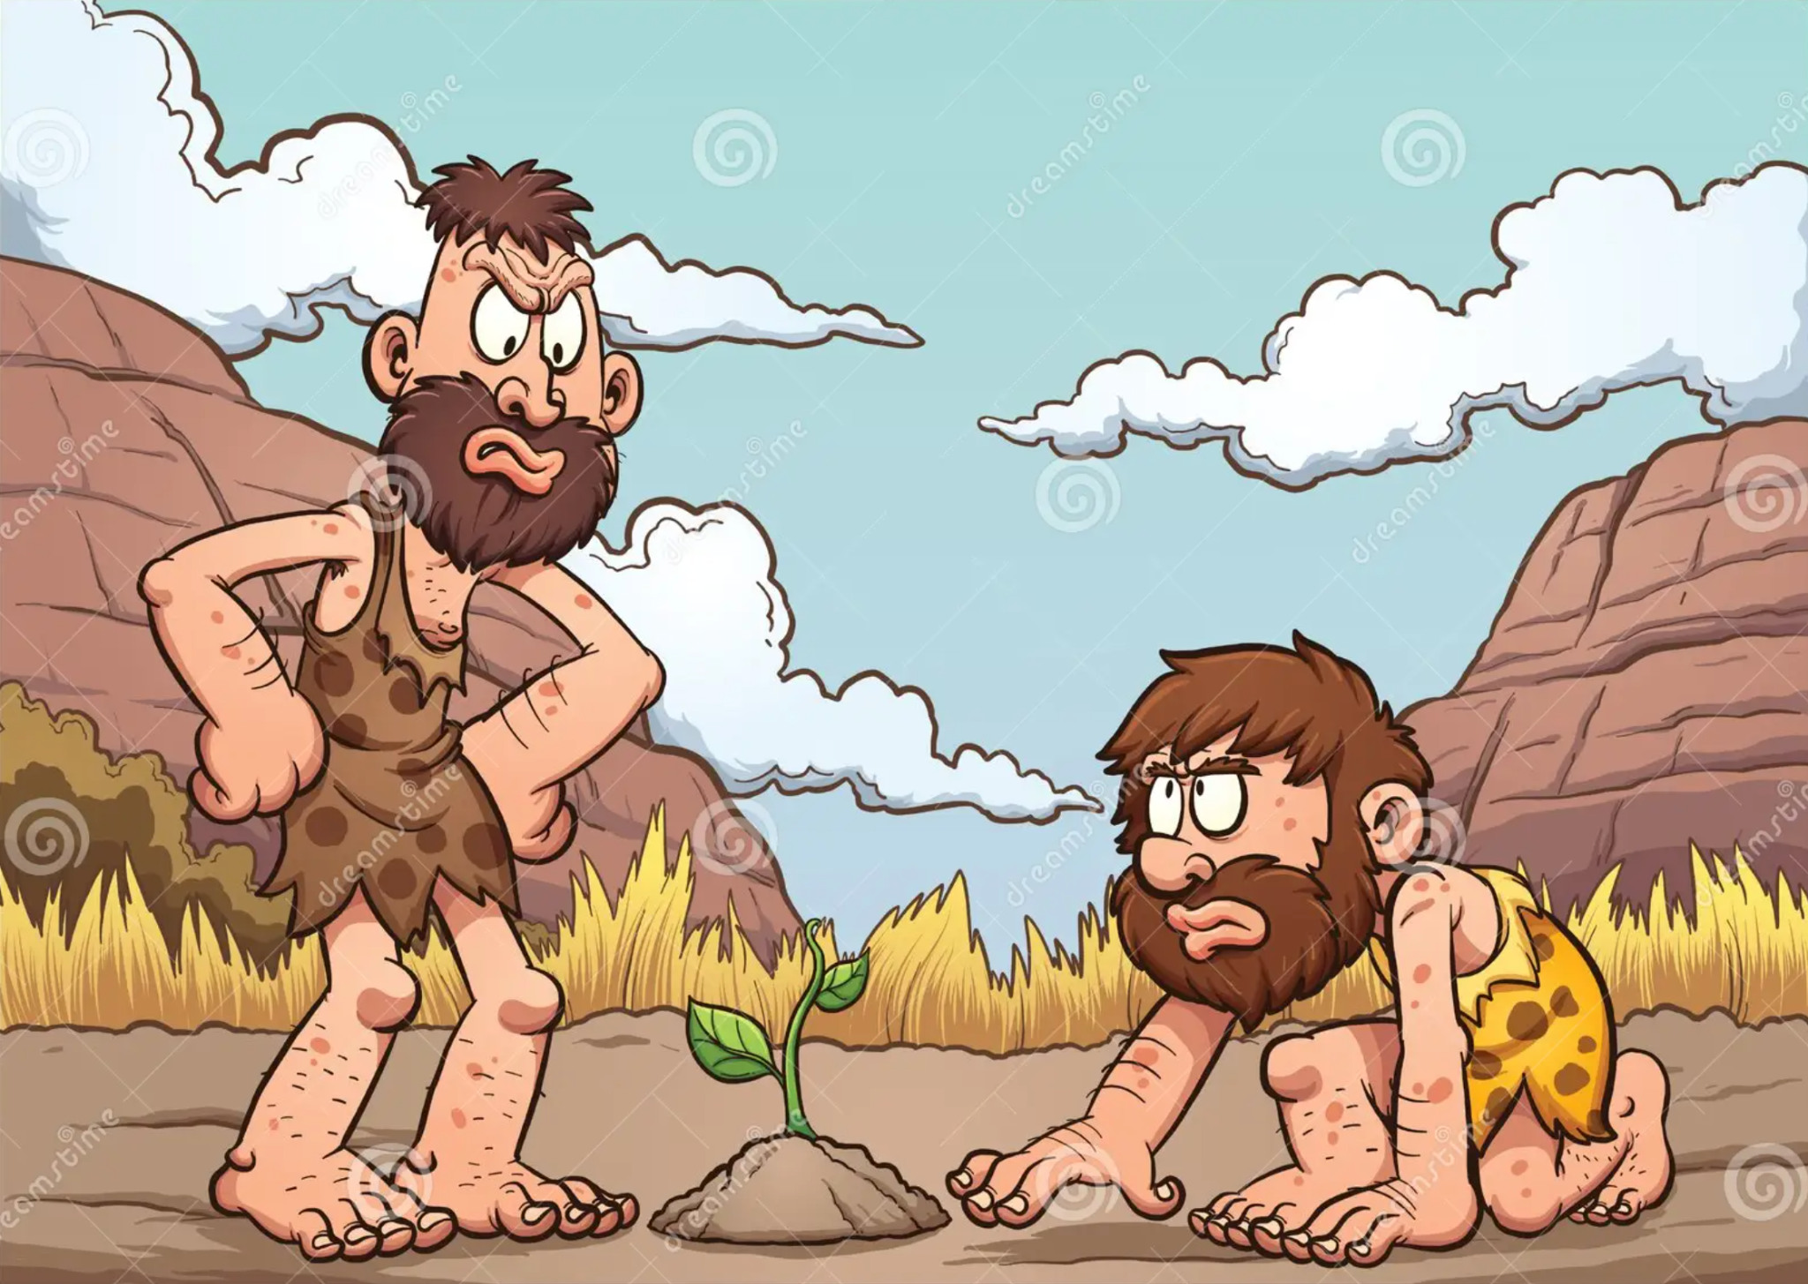
Once upon a time, in a land far far away

Slide 5
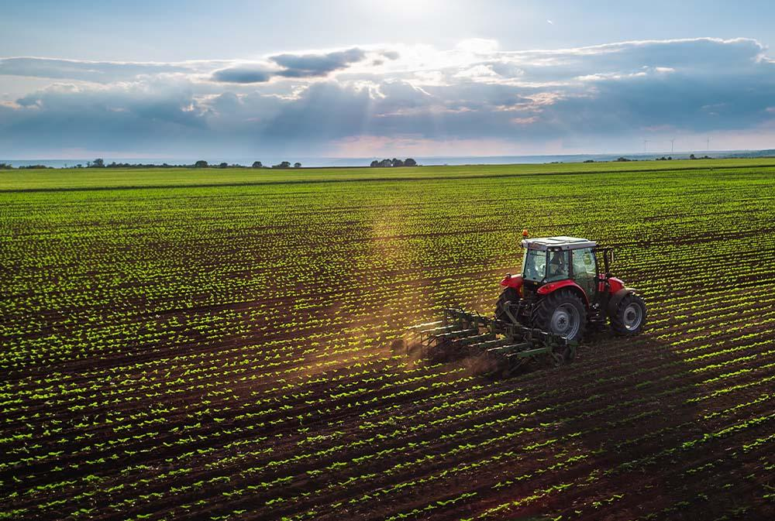

Slide 6
BUT…
Reliance on weather conditions
Resource wastage
Pests and diseases
Land constraints

Slide 7
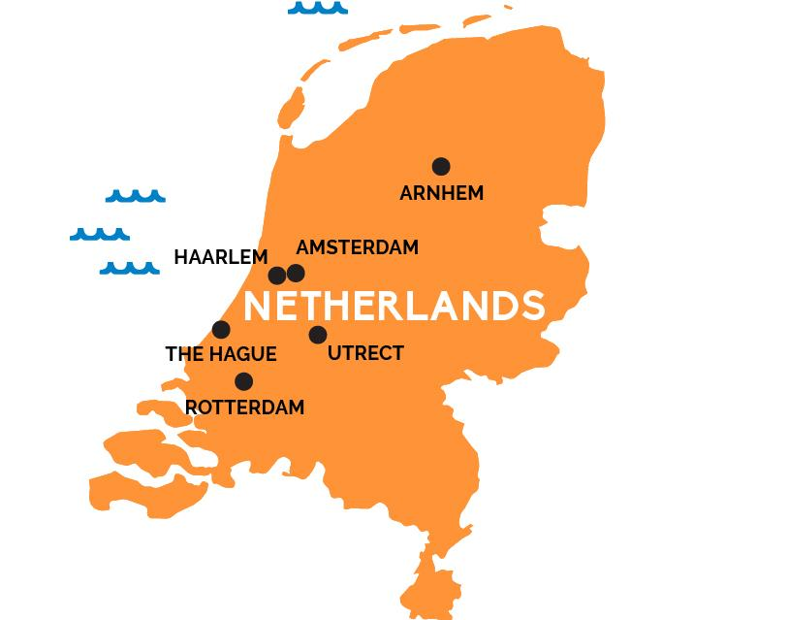
BUT…
Reliance on weather conditions
Resource wastage
Pests and diseases
Land constraints

Slide 8
2nd largest food exporter in the world
Notes:
Comparatively, amount of farmland in the US = 361million hecatares

Slide 9
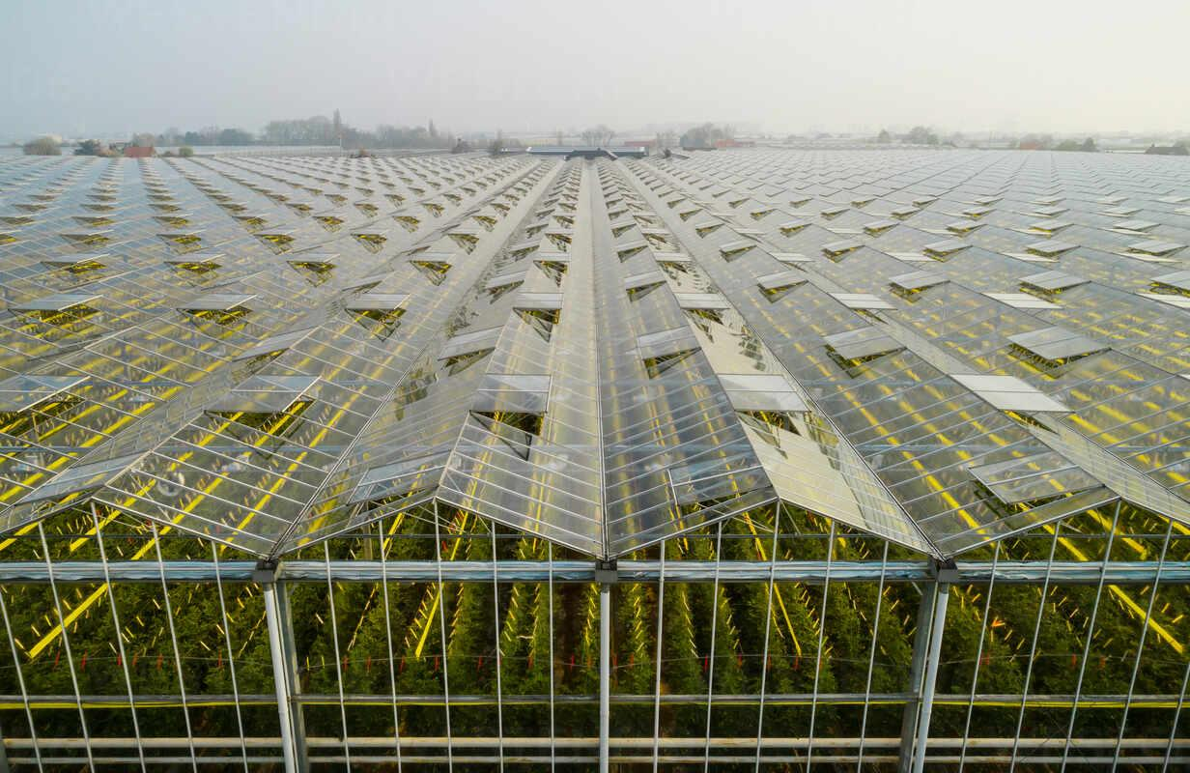
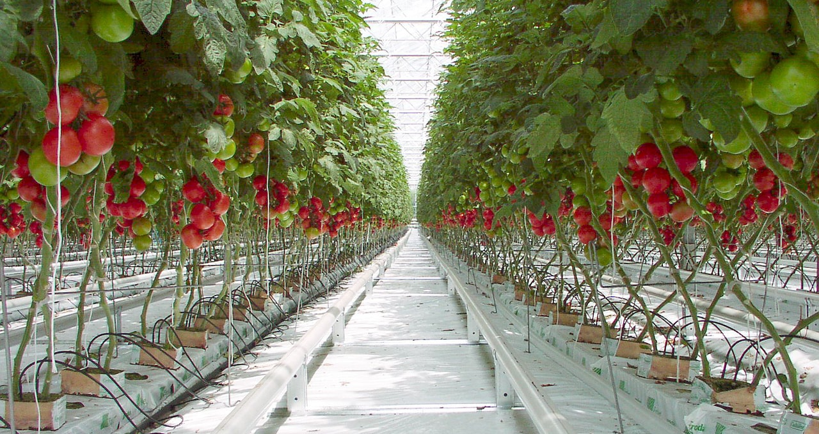

Slide 10
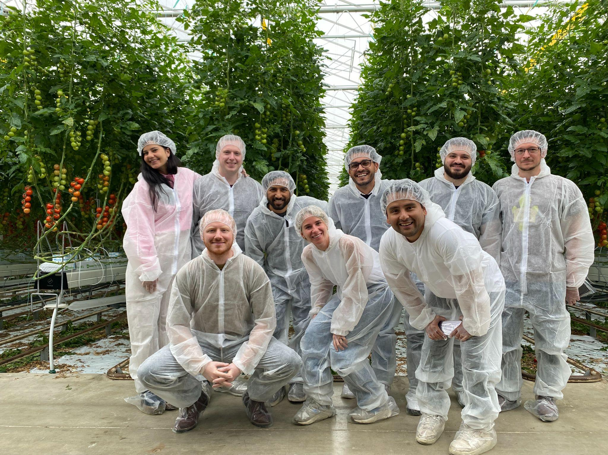

Slide 11
Software that empowers growers in indoor farms

Slide 12
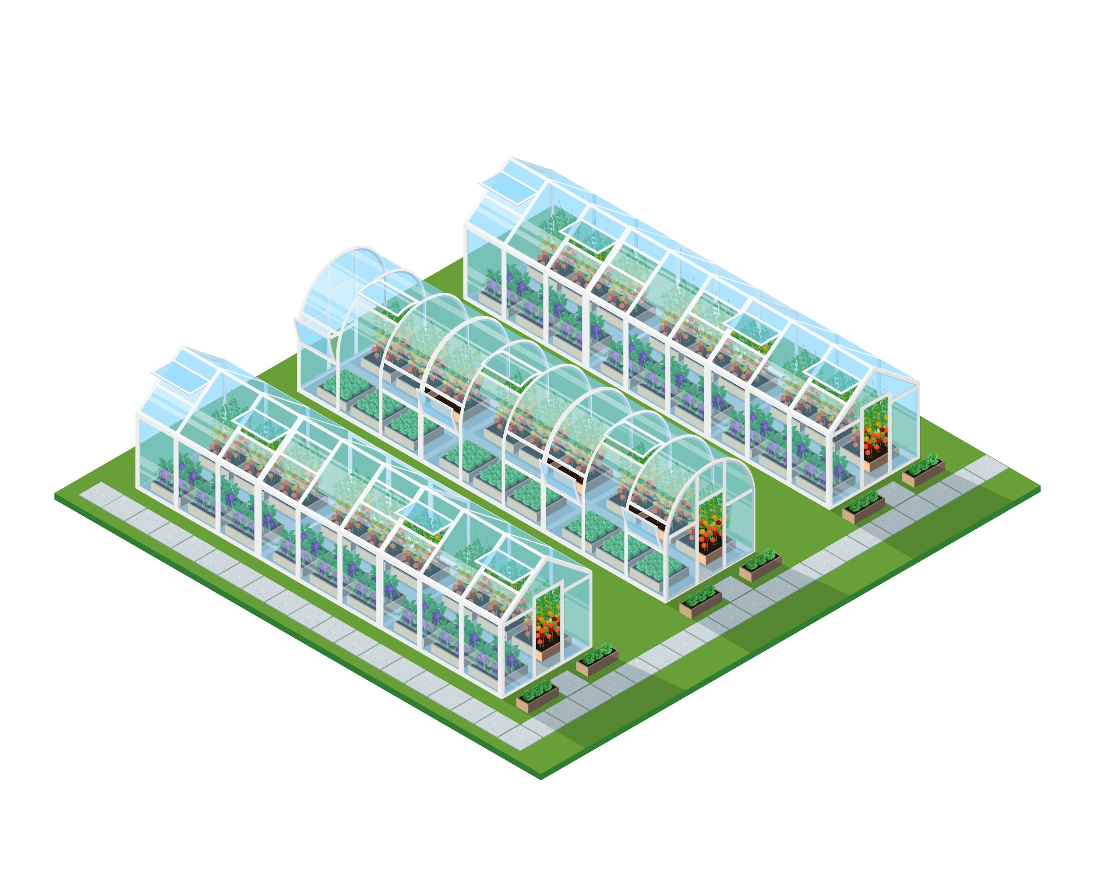


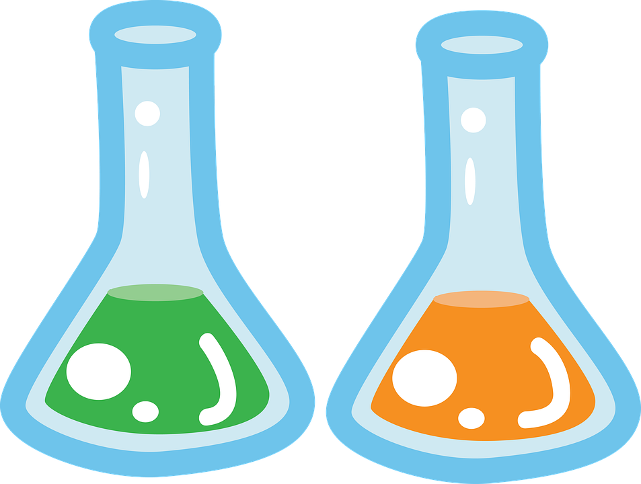
Monitoring and Observability
Automation and Control
Forecasting
Plant Science

Slide 13







How python fits in

Slide 14

Democratize access to
sufficient fruit & vegetables without breaking our planetary boundaries

Slide 15
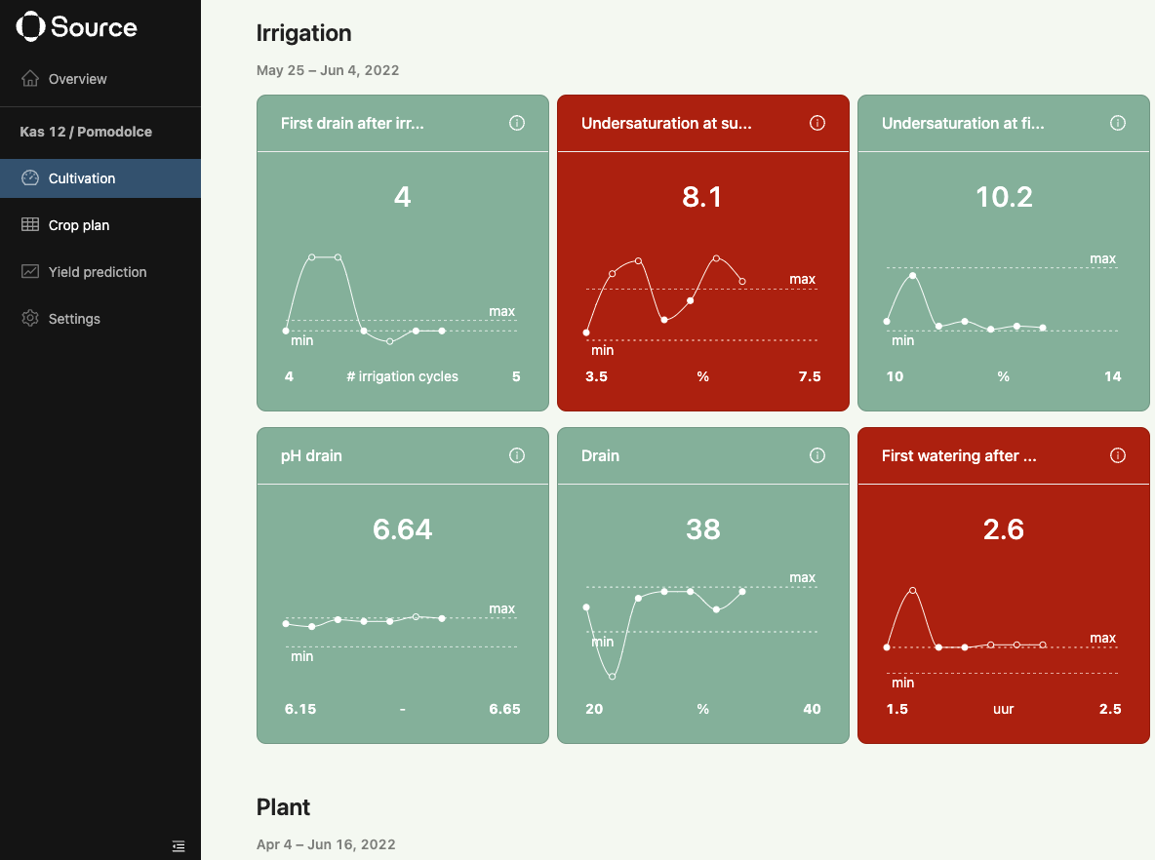
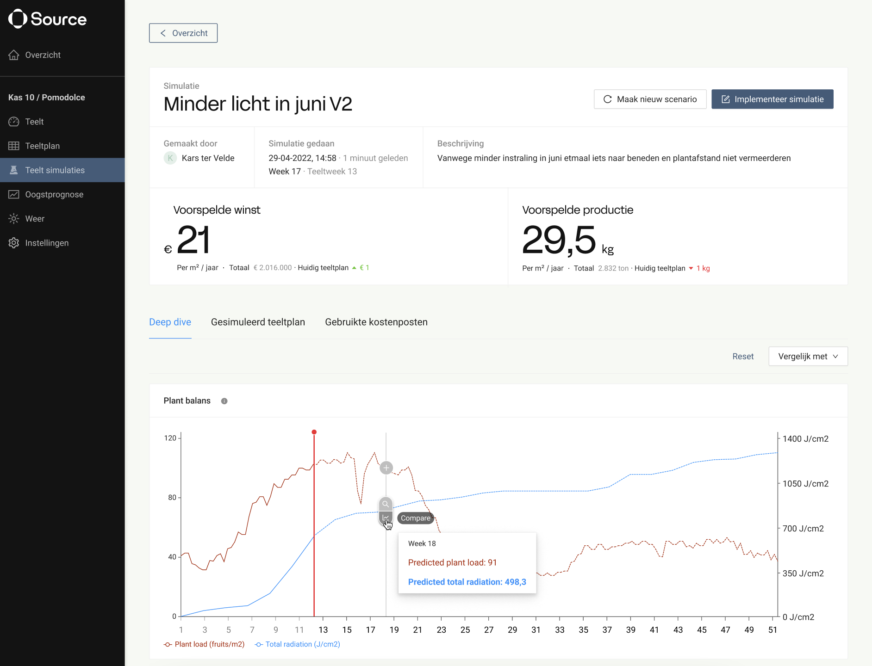
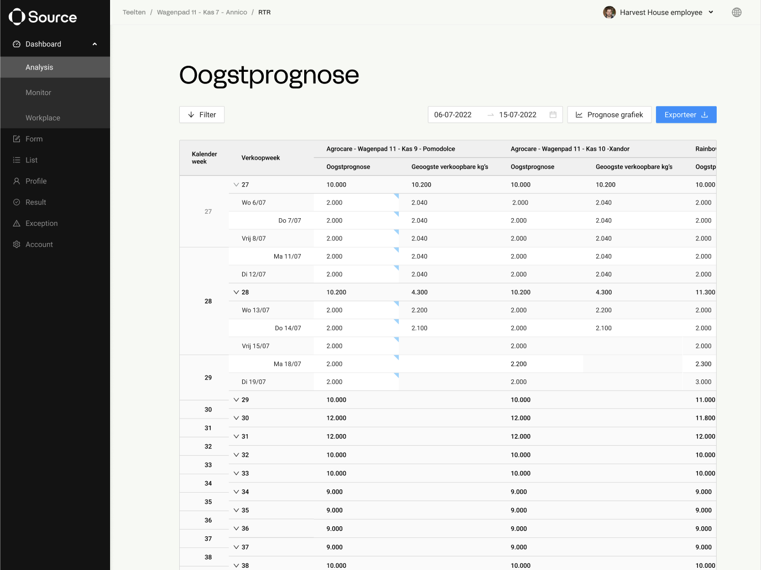
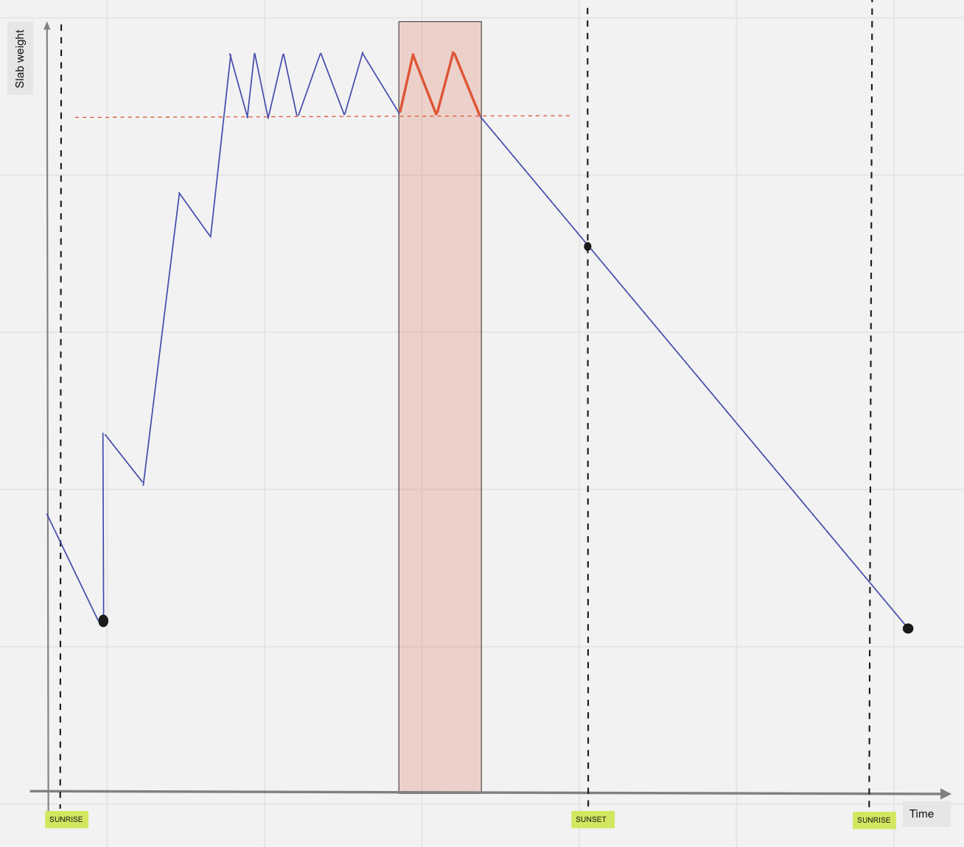
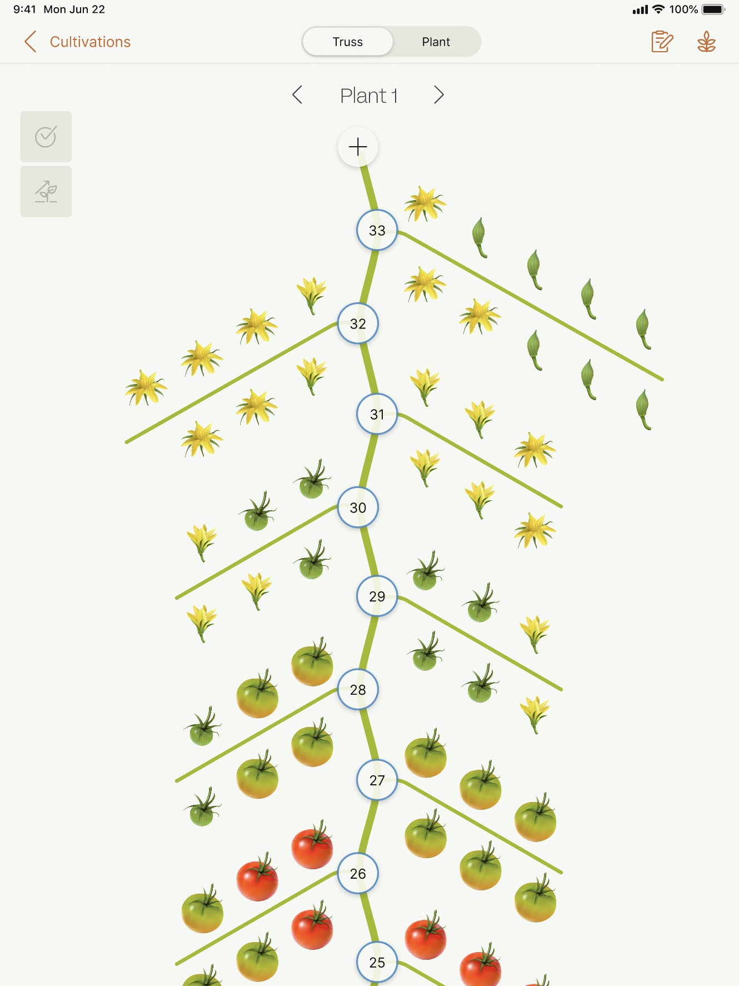

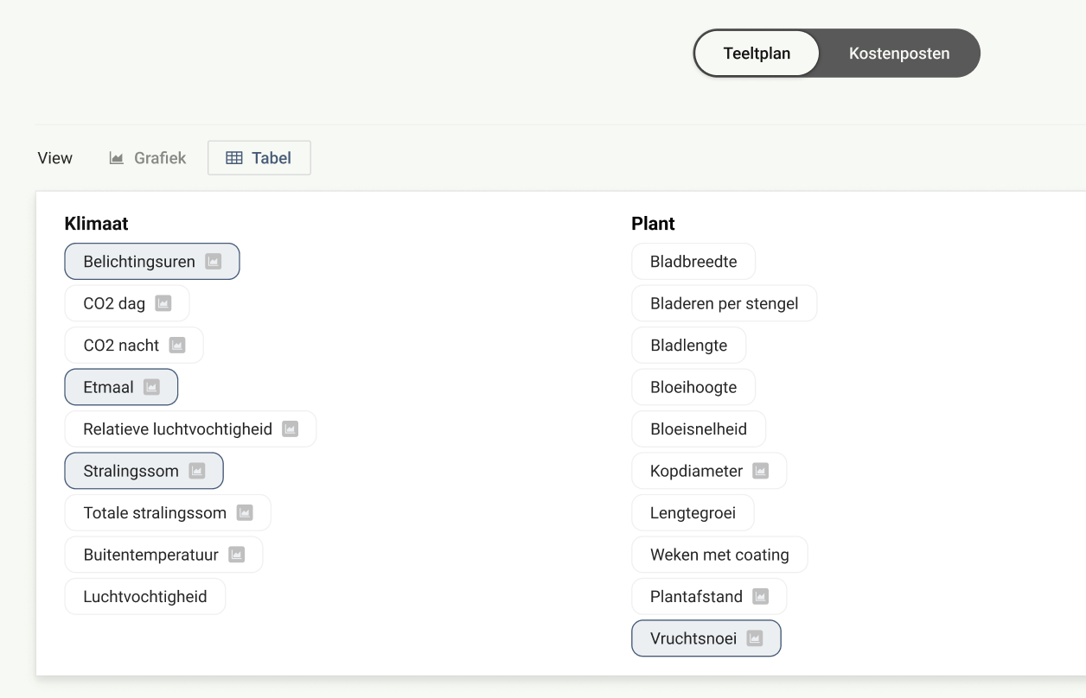
Products of Source.ag
Source Track
Source Cultivate
Source Control
Observability Digital greenhouse
Forecasting Cultivation co-pilot
Automation Greenhouse autopilot

Slide 16

When is the best time for me to change stem density?
How much should I change my temperature to get the highest possible harvest?

Slide 17

We have a unique hybrid approach combining plant science and data science
With a plant science only approach, an infinite amount of (costly) experiments is required to comprehend the full plant behavior depending on its environment
The amount of data is too small for a black-box approach where we let the data speak for itself to build models
Plant science
A.I.
Source combines both paradigms to build performant and robust AI models which require a much smaller amount of data, and generalize to all crop types

Slide 18
Forecast system

Slide 19
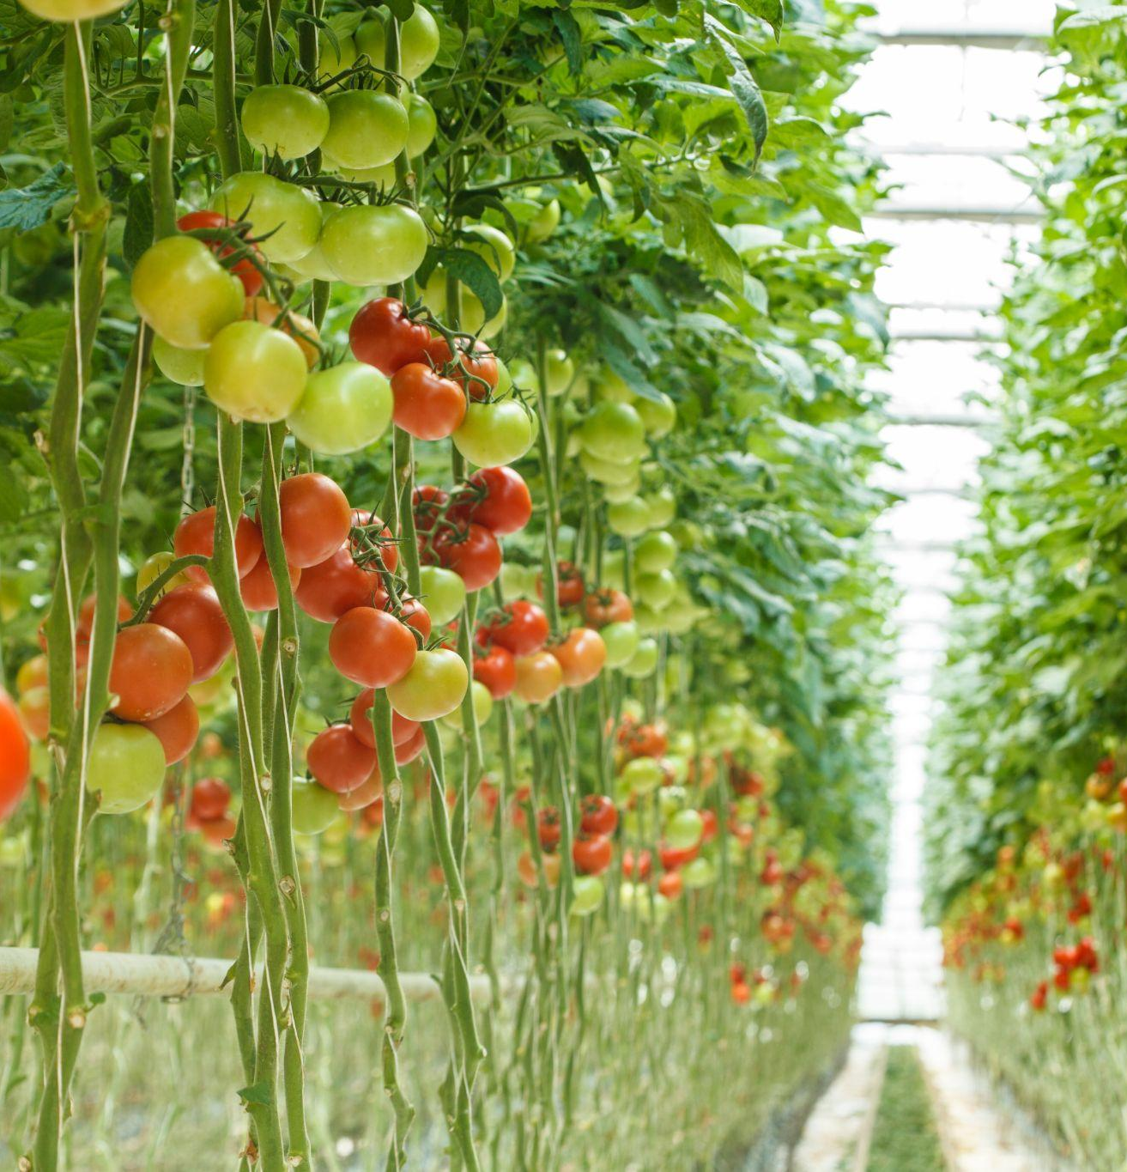
Plants in greenhouses generate thousands of data points every day
Outside climate
Climate set-points
Plant actions
5-min climate measurements
Plant measurements
Plant images
Greenhouse attributes
Sensor data

Slide 20


Forecast system
Model

Slide 21
Data pipelines
Forecast system
Model

Slide 22

Data pipelines
Exploration
Feature Engineering
Training
Forecast system
Model
Evaluation
Input from existing literature

Slide 23
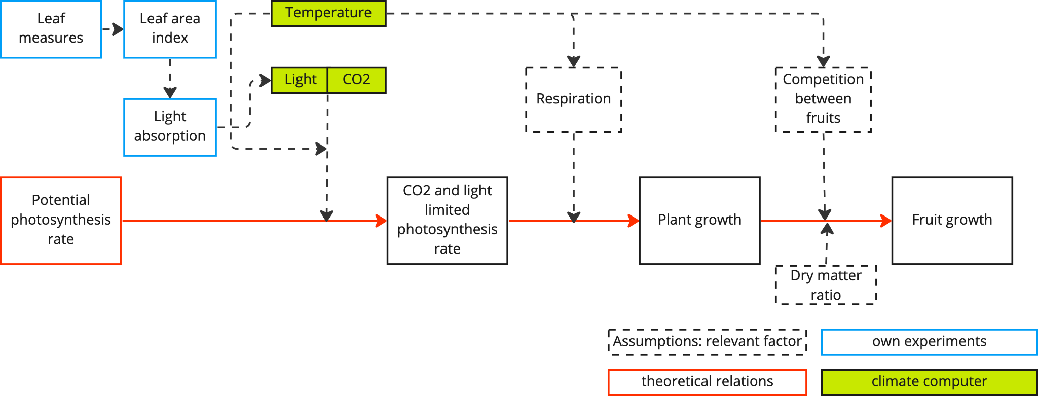

The photosynthesis processes are complemented by fitting models in cultivate
Deep dive - pt. 2
PART 1: Assimilates generation:
Photosynthesis rate of plant
PART 2: Assimilates partitioning:
Competition between fruits and other plant parts
Statistical. Model
Notes:
So now a detailed view on photosynthesis:
First of all I am sure you have a deeper understanding of that.
What can you see on that:
Respiration:
Dark respiration (influenced by temperature)
Maintenance respiration (constant factor, where in fact it is dependent on

Slide 24

Data pipelines
Exploration
Feature Engineering
Training
Forecast system
Model
Evaluation
Input from existing literature

Slide 25
Data pipelines
Exploration
Feature Engineering
Training
API
Forecast system
Evaluation
Input from existing literature

Slide 26

Our experience with python
Excellent support for data science libraries
Fast prototyping
Easy to pick up
Maintainability in production systems

Slide 27
Questions

Slide 28
Backups

Slide 29

Through the climate computer, the grower calibrates climate and irrigation settings. The climate settings are very complex and influence each other
Climate Computer
Actuator
Influence
Climate
Plant status
Ventilation window
T°
Energy screen
…
AH
Dry-down
Heating
CO2
Supplemental light
…
PAR
CO2 supply
Irrigation

Slide 30
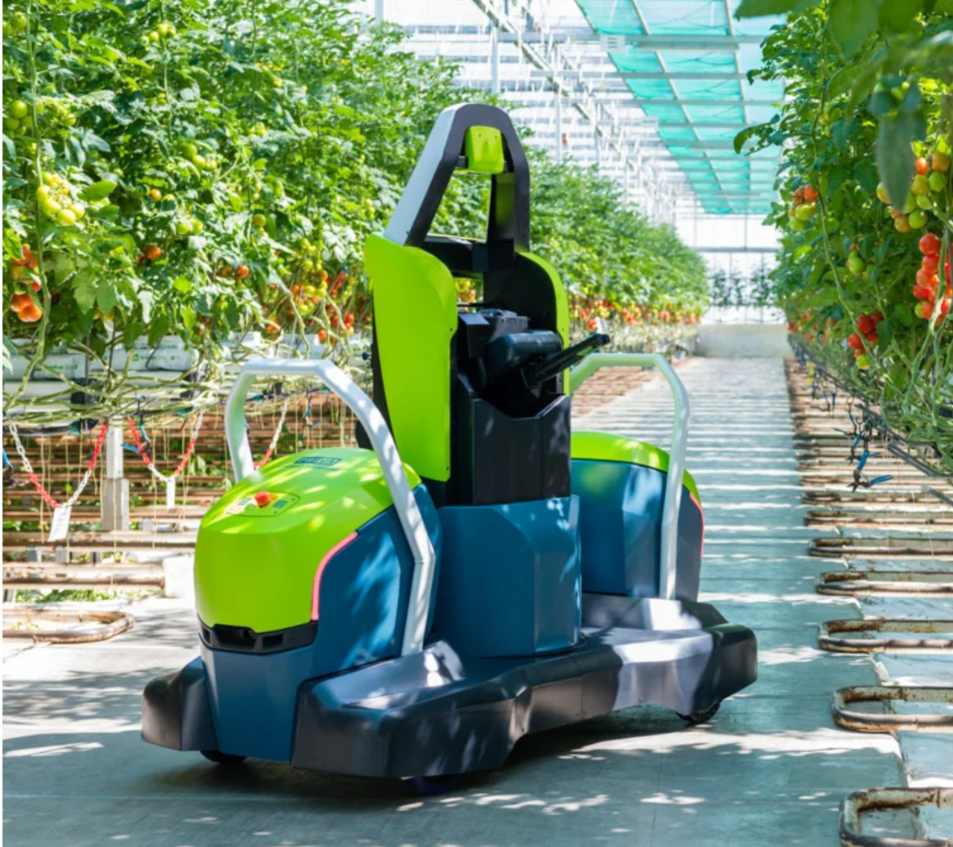
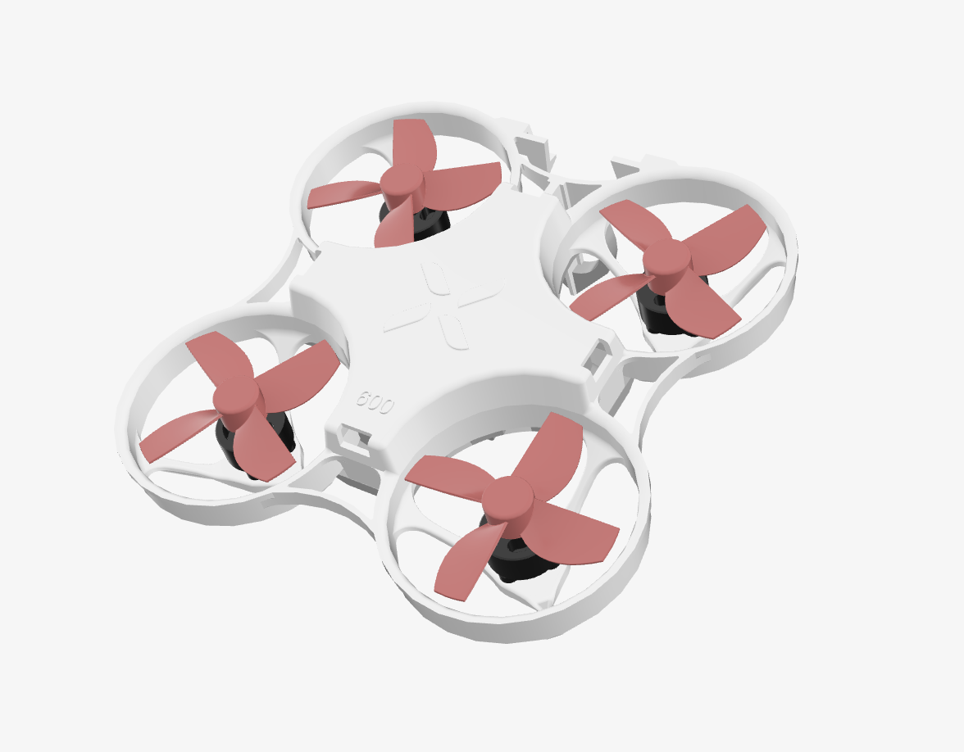
Automation

Slide 31
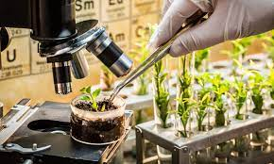
Plant Science
Plant breeding
Research and experimentation

Slide 32
Forecasting and predictions
Instead of this slide, do you want to use the following two?
Weather forecasts
Harvest predictions
Estimating resource costs

